Slide 1
Top Down Modelling
(Kroenke Ch. 3 and others)
Horst Holstein, Nigel Hardy, 2000

Slide 2





Slide 3
Design Approach
Business Rules
  Infer from user requirements
  Must be documented
  Incorporate in DBMS design where possible
  Satisfy through action of application programs (queries, access paths)

Slide 4
Design Approach (cont’)
Bottom Up
  start with existing design
Top Down
  create new design
Combination of both

Slide 5
Semantic Modelling
Capture meaning of an enterprise
  determine the business rules
  formalise
  be meaningful to client and analyst

Slide 6
Entity Relationship Model
Introduced by Chen in 1976
Elements are:
  Entities
  Relationships
  Attributes (Properties)

Slide 7
Entity
Something that must be tracked
Entity class
  collection of entity instances possessing a common properties structure or format
Entity Instance
  a particular entity class member, described by values of its properties (attributes)
  identifiable (key)

Slide 8
Relationship
an association between entities
  referential integrity required
a Relationship Class associates Entity Classes:
(Student, Major)
  a Relationship Instance associates Entity Instances: (Li,CS)
can have properties (attributes): (Student, Major,Mark)

Slide 9
Relationship Degree
number of participating entities
  binary, ternary,n-ary
    Student - Major: (binary)
    Student - Major - Faculty: (ternary)

Slide 10
Relationship Funtionality Binary case
1:1 e.g. Car - Employee,
Country - Head of State
1:N e.g. Director - Film,
Operator - Tour
M:N e.g. Student - Module, Bookshop - Title

Slide 11
Relationship
Membership Class
Mandatory (Total) participation
  “Each student has a supervisor”
Optional (Partial) participation
  “A student may have a supervisor”

Slide 12
Entity relationship diagram
Entity Class
  rectangle
Attribute
  ellipse, or listed separately
Relationship Class
  diamond
  maximum cardinality, inside
  minimum cardinality, externally

Slide 13
E-R Examples
0
1:1
1
Student
Computer
1
1:N
0
Person
Car
0
M:N
0
Student
Module

Slide 14
Explanation of example 1
“for every student there is at most 1 computer, and at least one computer
”for every computer, there is at most one student and at least (ie there may be) no student”

Slide 15
Explanation of example 2
“for every person, there may be many cars, and there may be none”
“for every car, there may be at most one person(owner) and at most one person

Slide 16
Explanation of example 3
“for every student there may be many modules and there may be none”
“for every module, there may be many students and there may be none”

Slide 17
Weak entity
Cannot exist in the dbase unless another entity is present
e.g. Employee – Dependent.
Notation: by rounded corners.
ID dependent entities occur when one identifier is also part of another e.g. Building Name, Apartment No.

Slide 18
Subtype entity
Part of the extended E-R model
e.g. employee/supervisor
Notation: similar to Kroenke, p57
Subtype
  uses same identifier (key)
  inherits attributes of supertype
  may have own attributes

Slide 19
Subtypes (1)
Employee
1
1
Clerical
Technical
Managerial

Slide 20
Subtypes (2)
Client
0
m
NT User
UNIX User
Mainframe User

Slide 21
Explanation of notation
“an employee must belong to one of the subtypes, but may belong to only one of the indicated subtypes”
“a client need not belong to any of the indicated subtypes (0), but may belong to any one or two or to all of the indicated subtypes (m)”

Slide 22
Hospital Example
Part 1: The E-R diagram
Ref.: Database technology, Hughes G. John
Prentice Hall 1988
ISBN 0 13 197906-X

Slide 23
N:1
1:N
treats
supervises
CONSULTANT
1
0
0
0
Is-a
1
0
P- PATIENT
SURGEON
1
M:N
0
performs
1:N
1
Is-a
0
1:N
0
assists
0
PATIENT
1
0
OPERATION
0
N:1
1:N
0
undergoes
located
occupies
WARD
THEATRE
1:N
In theatre
0
N:1
0
0
NURSE
0
In ward

Slide 24
Business/Enterprise Rules
The E-R diagram should model, not dictate, these rules, BUT
Each binary relationship suggests 4 cardinality constraints
  semantic information
If not present in the rules,
  rules are incomplete
  open to ambiguous interpretation
  consult, add, document !

Slide 25
Additional Rules
4 numbers on all relationships does not mean a complete model
you will not be able to represent all you are told
E-R is necessary but not sufficient
  it is not sufficiently expressive for all situations

Slide 26
Other enterprise rules
“A nurse cannot be assigned to both a ward and a theatre (or neither)”
“A football squad must have at least 11 players”

Slide 27
Connection Traps
Misinterpretation of the E-R diagram might suggest relation-ships that do not exist
  Fan trap
  Chasm trap
If indeed we need a relationship “across the trap”, then the model of the business is inadequate.

Slide 28
Fan Trap (N:1,1:N)
N:1
1:N
SUPPLIER
PART
JOB
FACTS TO STORE
S1-P1-J1
S2-P1-J1
S3-P1-J1
S4-P1-J3
S# P# J#
1 1 1
2 2 2
3 3
4 4
CANNOT find which supplier Is associated with which job ( S4-P1-J1 ?? )

Slide 29
Chasm Trap (N:1,N:1)
N:1
N:1
SUPPLIER
JOB
PART
S# J# P#
1 1 1
2 2 2
3 3 3
4 4 4
5
6
FACTS TO STORE
S1-P1-J1 S4-P1-J3
S2-P1-J1 S5-P3-J4
S3-P1-J1
no relationship between supplier and part
S6-P4 requires a fictitious job

Slide 30
Hospital example
Where are the traps?
Can they be ignored?
What enterprise rules might be affected?

Slide 31
N:1
1:N
treats
supervises
CONSULTANT
1
0
0
0
Is-a
1
0
P- PATIENT
SURGEON
1
M:N
0
performs
1:N
1
Is-a
0
1:N
0
assists
0
PATIENT
1
0
OPERATION
0
N:1
1:N
0
undergoes
located
occupies
WARD
THEATRE
1:N
In theatre
0
N:1
0
0
NURSE
0
In ward

Slide 32
Transformation of E-R Model into relational db design
Entities and relationships transform into a single datastructure: the relation

Slide 33
Entities to Relations
Start off by representing each entity class as a relation
Add attributes to be recorded
Indicate primary key
Do it for hospital example

Slide 34
Hospital Example
PATIENT{P#,PName,PAddress,Dob,Sex}
P_PATIENT{PP#}
WARD{W#,WType}
NURSE{N#,Name,Grade}
OPERATION{Op#,Type,Date,Time}
SURGEON{Sname,SAddress,Tel#}
CONSULTANT{Cname,Speciality}
THEATRE{T#,TheatreType}

Slide 35
Relationships to Relations
Bring keys of associated entities together by
  Mandatory case: posting key(s) as “foreign key(s)” into an existing “host” relation,
  Optional case: creating a new relation (denoted by R) posted with all associated (foreign) keys
    assign prime attributes in accordance with semantics

Slide 36
Notation
Prime attribute: underline (& bold)
Foreign key: (.)*
#: attribute indicator (numeric data)
App.: enforcement of a constraint via application code (run-time integrity enforcement)
  aim to achieve enforcement by relational model where possible

Slide 37
The three cases without additional constraints
0
1:N
0
A(A#, …)
B(B#, …)
A
B
R(B#*, A#*)
1
1:N
0
A(A#, ...)
B(B#, A#*...)
A
B
0
M:N
0
A(A#, …)
B(B#, …) R(A#*, B#*)
A
B

Slide 38
Application Code
Integrity Checks (1)
App
1
1:N
1
A(A#,...)
B(B#, A#*,...)
A
B
Checks of this form are saying:
  “Every A# must participate with B, ie appear in B at least once”
  or
  A[A#]=B[A#]

Slide 39
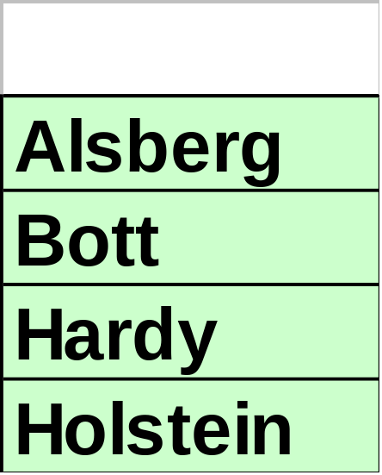
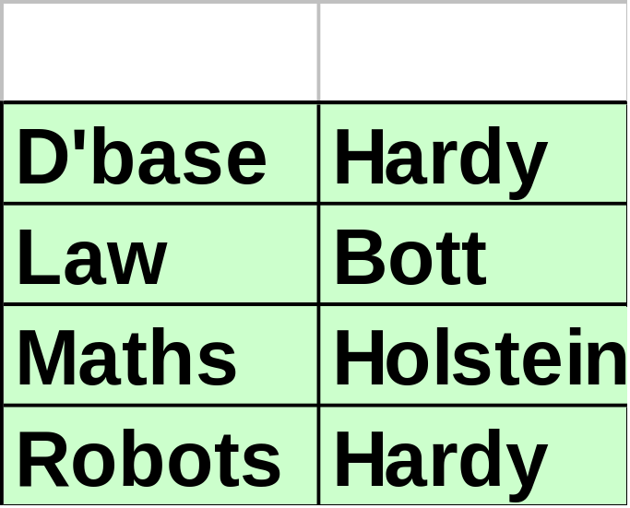
E.g. Mandatory 1:N (11:N1)
App
Lec(Lec,...)
Mod(Mod, Lec*,...)
1
1:N
1
Lec
Mod

Slide 40
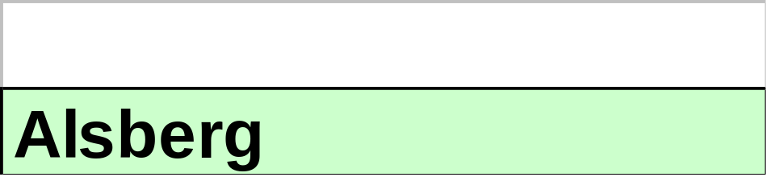
MS SQL for Query checking enterprise rule
SELECT LEC.[Lec]
FROM LEC
WHERE
(LEC.[Lec] NOT IN (SELECT [Lec] FROM MOD);

Slide 41
Application Code
Integrity Checks (2)
App
0
M:N
1
A(A#,…)
B(B#,...)
A
B
R(A#*,B#*)
Checks of this form are saying:
  “Every A# must participate with B, ie appear in R at least once”
  or
  A[A#]=R[A#]

Slide 42
Binary (1:1) Relationships
No
Duplicates
No
Duplicates
1:1
R(A#*,B#*)
or
R(A#*,B#*)
0
0
A(A#,…)
B(B#,…)
A
B
1
1:1
0
A(A#,…)
B(B#, A#*…)
A
B
Not Null &
No Duplicates
Not Null &
No Duplicates
0
1:1
1
A
B
c.f. above (interchange A & B)
App
1
1:1
1
A(A#,…)
B(B#, A#*…)
A
B

Slide 43
Binary (1:N) Relationships
0
1:N
0
A(A#,…)
B(B#,…)
A
B
R(A#*,B#*)
1
1:N
0
A(A#,…)
B(B#, A#*,…)
A
B
App
0
1:N
1
A(A#,…)
B(B#,...)
A
B
R(A#*,B#*)
App
1
1:N
1
A(A#,...)
B(B#, A#*,...)
A
B

Slide 44
Binary (M:N) Relationships
0
M:N
0
A(A#,…)
B(B#,…)
R(A#*,B#*)
A
B
App
1
M:N
0
A(A#,…)
B(B#,…)
R(A#*,B#*)
A
B
App
0
M:N
1
A(A#,…)
B(B#,...)
A
B
R(A#*,B#*)
App
App
1
M:N
1
A(A#,...)
B(B#,...)
A
B
R(A#*,B#*)

Slide 45
Schema semantics
Which of the foregoing 12 cases have the same relational schema, but differ only in their constraints?
Can you formulate some simple rules that categorise these results?

Slide 46
Summary of Relationship
Transformation
Decide whether an existing relation can host the foreign keys of the other participating entities as nonprime attributes, or
whether keys of the participating entities must be placed in a new relation
  choose the minimal key
document additional constraints

Slide 47
M:N Decomposition
1
1:N
N:1
1
A
R
B
A(A#, …)
B(B#, …)
This is exactly the same relational schema as for the M:N relationship below.
R(A#*, B#*, …)
A
0
M:N
0
B
Note: A pair of M:N’s leads to a fan trap.

Slide 48
Support for M:N relationships
Not all relational db systems give direct support for M:N relationships.
They do, however, give support for 1:N relationships.
Example: Access graphical interface.

Slide 49
Subtype (Is_A) relationship
Define a relation for the Supertype
  Person
Define a relation for each subtype
  Undergraduate, Postgraduate, Staff
Post Key of Supertype as primary key into subtype.
  Every subtype key instance equals a supertype key instance, but not necessarily vice versa, hence directional inheritance.

Slide 50
CONSULTANT
Is-a
1
0
P- PATIENT
SURGEON
1
Is-a
0
PATIENT

Slide 51
Hospital2 - Subtype Relationships
SURGEON{Sname#, SAddress, Tel#}
CONSULTANT{Cname*(ref SURGEON), Speciality}
PATIENT{P#, PName, PAddress, Dob, Sex}
P_PATIENT{PP#*(ref PATIENT)}
Note that the DBMS will be able to ‘look up’ inherited attributes

Slide 52
N:1
treats
CONSULTANT
1
0
P- PATIENT
SURGEON
1
performs
1:N
1:N
0
PATIENT
1
0
OPERATION
0
N:1
1:N
0
undergoes
located
occupies
WARD
THEATRE

Slide 53
Hospital3 - 1:N relationships mandatory
Treats:
  P_PATIENT(P#* (ref PATIENT) ,
  Cname* (ref CONSULTANT))
Occupies:
  PATIENT(P#, Pname, Paddr, DOB,
  Sex, W#* (ref WARD))

Slide 54
Hospital3 - 1:N relationships mandatory cont’
Located, Undergoes, Performs
  OPERATION(Op#, Type,Date,Time,
  T#* (ref THEATRE),
  P#* (ref PATIENT),
  SNAME* (ref SURGEON))

Slide 55
1:N
supervises
CONSULTANT
0
0
SURGEON
WARD
THEATRE
1:N
In theatre
0
N:1
0
0
NURSE
0
In ward

Slide 56
Hospital4 - 1:N relationships optional
  SUPERVISES(SName#*(ref SURGEON)
  Cname*(ref CONSULTANT))
  IN_WARD(N#*(ref NURSE),W#* (ref WARD))
  IN_THEATRE(N#*(ref NURSE),
  T#*(ref THEATRE) , DateAssigned)

Slide 57
SURGEON
M:N
0
0
assists
OPERATION

Slide 58
Hospital5 - M:N relationship
(optional)
  ASSISTS(OP#* (ref OPERATION),
  Sname*(ref SURGEON), Role)

Slide 59
Additional Rules?
The E-R diagram is helpful in highlighting possible compatibility/exclusivity situations.
Consider all entities participating in more than one relationship. Are the participations compatible or exclusive?
Action?

Slide 60
N:1
1:N
treats
supervises
CONSULTANT
1
0
0
0
Is-a
1
0
P- PATIENT
SURGEON
1
M:N
0
performs
1:N
1
Is-a
0
1:N
0
assists
0
PATIENT
1
0
OPERATION
0
N:1
1:N
0
undergoes
located
occupies
WARD
THEATRE
1:N
In theatre
0
N:1
0
0
NURSE
0
In ward

Slide 61
Hosp6: Additional Rules?
Can a patient be a private patient and be in a ward?
Can a nurse be assigned to a ward and a theatre?
Can a surgeon perform and assist an operation?
Consult, add, document, implement via application program

Slide 62
Hosp7: - Traps
Where are the fan traps?
Where are the chasm traps?
Can they be ignored?
What enterprise rules might be affected?

Slide 63
Top Down & Bottom Up
When top down and bottom up methods can be applied, it is useful to follow the sequence
top down → E-R diagram (1)
bottom up → rel. schema → E-R diag (2)
merge best features of (1) and (2)
merged E-R diag. → rel. schema

Slide 64
Data Model
A collection of
  data object types
  integrity rules
  operators
    retrieval, insertion, deletion, update, query, trigger

Slide 65
DB development - summary
Draw up client’s requirements
Design the system
Implement the system
Test the system
Refine the system
Deliver, customise
  dbms manager, users
Maintain the system

Slide 66
End of
Translating E-R Model into Relational Schema

